Slide 1

Level: Advanced
Game Development with Unity
Omid Saadat

Slide 2
Review Custom editor
Custom Propertie
Custom Inspector
Custom window
ScriptableObject

Slide 3
Ask your questions
+ more samples

Slide 4
Tween Libraries
What is tweening?
How can I use tweening?
Top Tween Libraries:
  Itween
  Gokit
  HoTween(DoTween)
  ZestKit

Slide 5
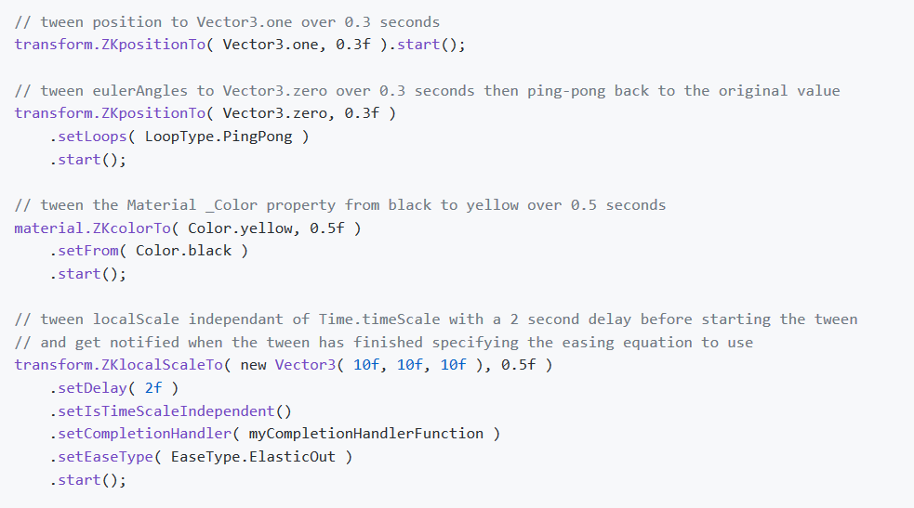
Using ZestKit
Download at ZestKit

Slide 6
Extensions
Transform extensions
...

